Slide 1

Joins
JOIN not JOINT

Slide 2
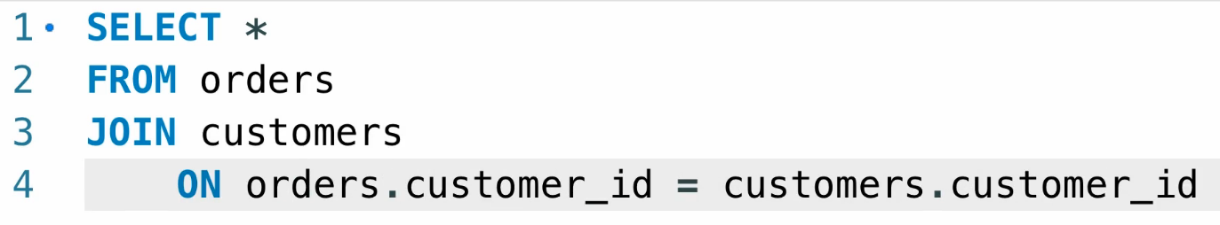
JOIN = INNER JOIN
Select columns from multiple tables. When we want to combine data from mutable tables we use JOIN

Slide 3
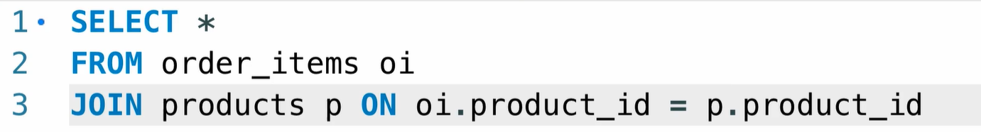
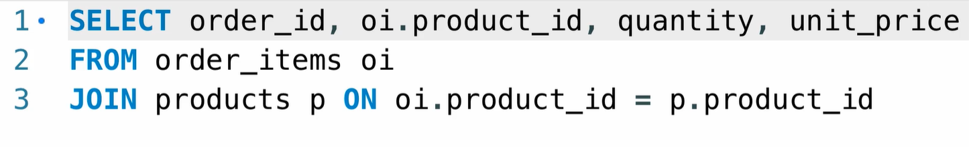
JOIN two tables

Slide 4
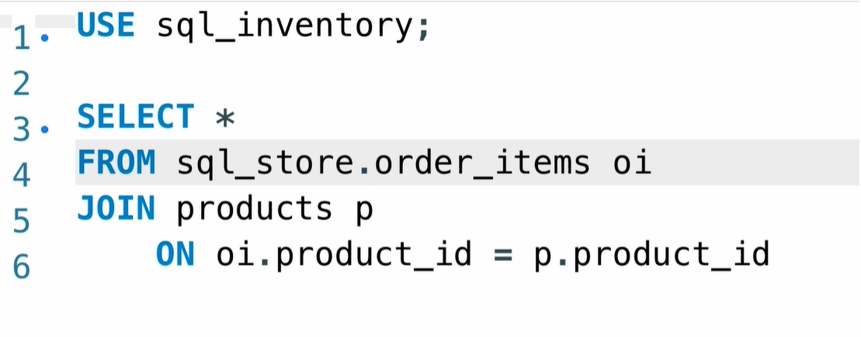
JOIN Across databases
Combine columns in tables cross multiple databases
USE keyword to set the database that we already use
When we are using table that is not in the current selected database when should add as prefix the database name before the table

Slide 5
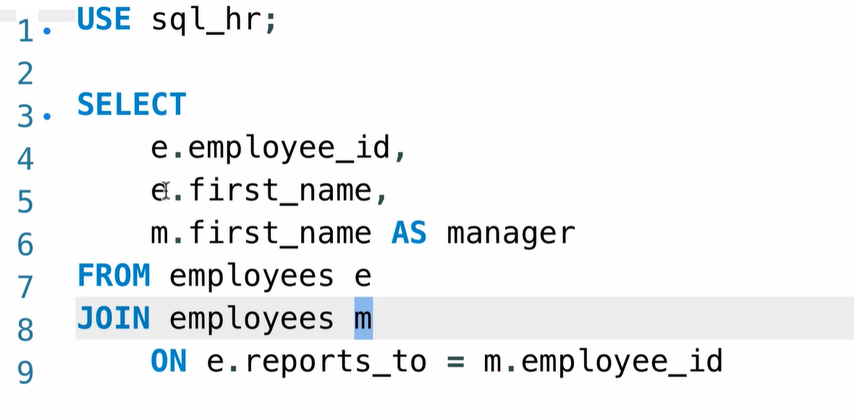
Self join
Select the current employee and there manager

Slide 6
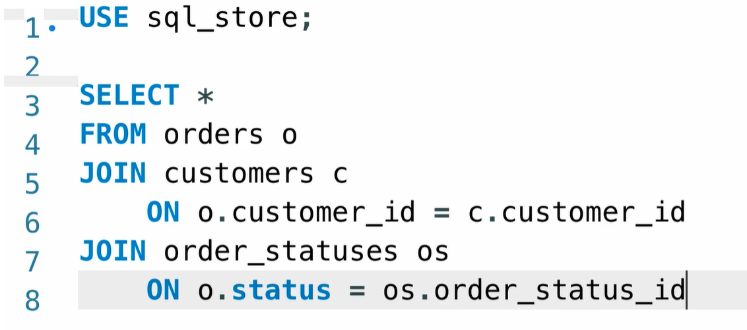
Joining Multiple Tables

Slide 7
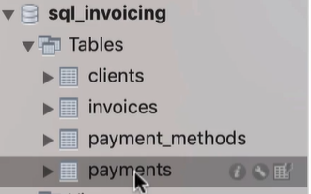
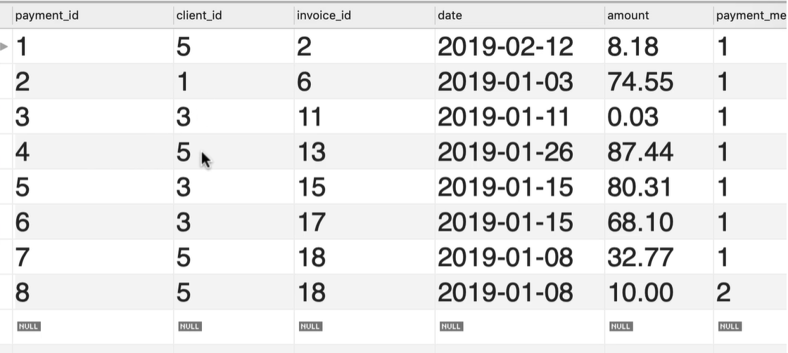
Exercise
Join the payments table with the client table and payment method table and replace
The ids with names

Slide 8
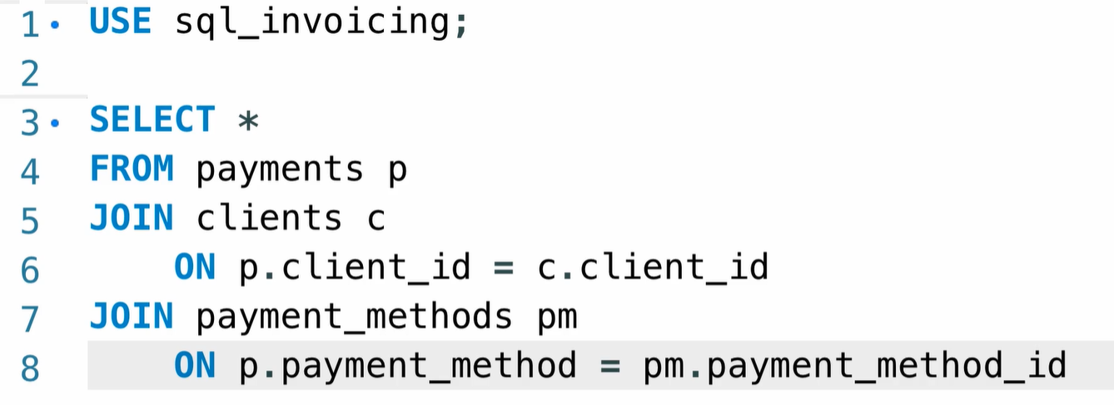
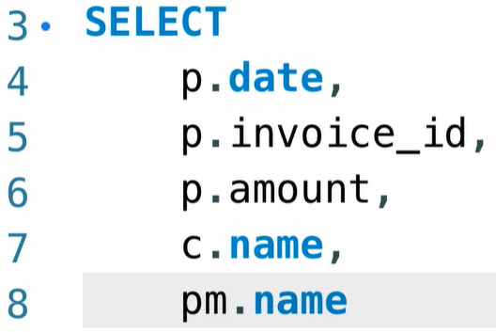
Solution

Slide 9
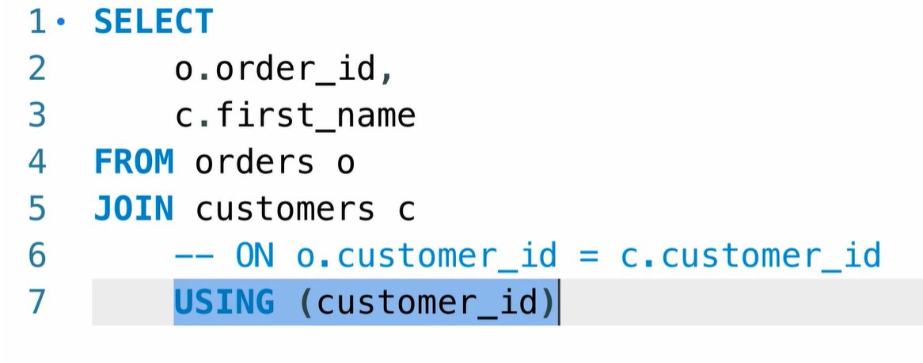
On and using the same
USING Clause

Slide 10
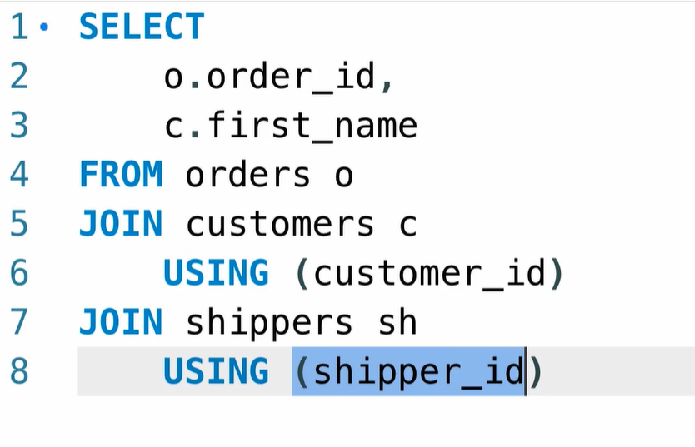
USING Clause
In both tables we have the same column name
The same column shipper_id & customer_id in both customers and shippers

Slide 11
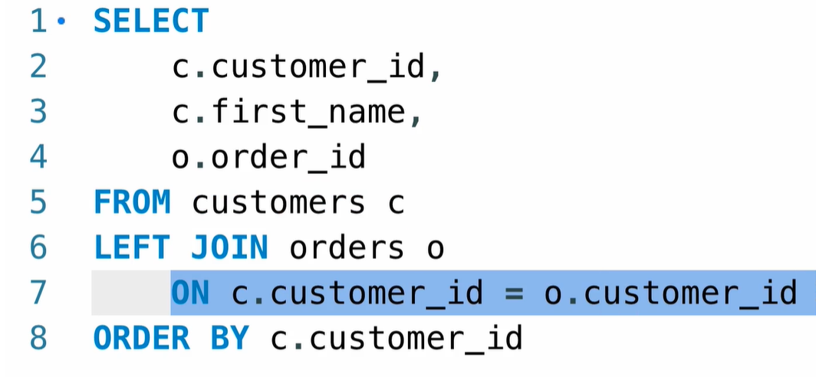
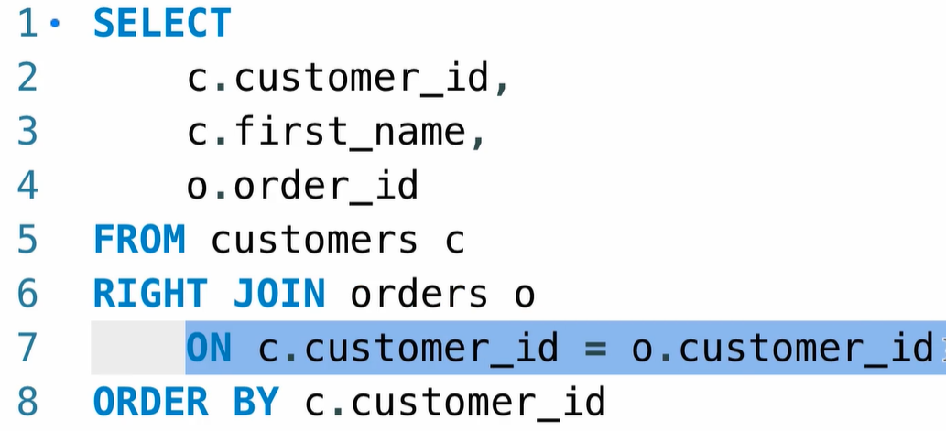
Left join, all the record will return whether if the condition true or not. In the example below the all the data from the customer table will be returned
Right join, all the record from the order table will be retuned whether the condition is true or not

Slide 12
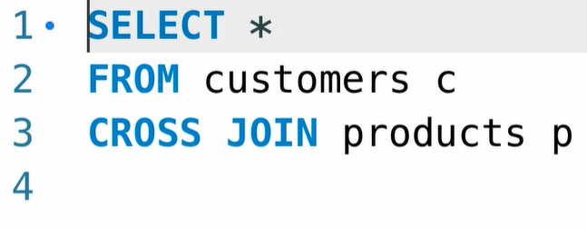
CROSS JOIN, every record from the customer table will be combined with every record from the product table, because of that we don’t have ON

